Slide 1
Ch5-4 Models of Memory Consistency

Slide 2
Cache coherence
Cache coherence ( Value, same location)
“Common Sense”
P1 Read[X] => P1 Write[X] => P1 Read[X] will return X
P2 Read[X] => P1 Write[X] => will return value written by P1
P1 Write[X] => P2 Write[X] => Serialized (all processor see the writes in the same order)

Slide 3
Objective of Cache Coherence
Maintain the integrity of data in cache and memory
What value can be returned by a read.
Keep the performance of multiple processors
Make cache transparent to the processors (not always true)
“If P writes x and P1 reads it, P’s write will be seen by P1 if the read and write are sufficiently far apart”
Haven’t solve the problem
When must a processor see a value that has been updated by another processor ?

Slide 4
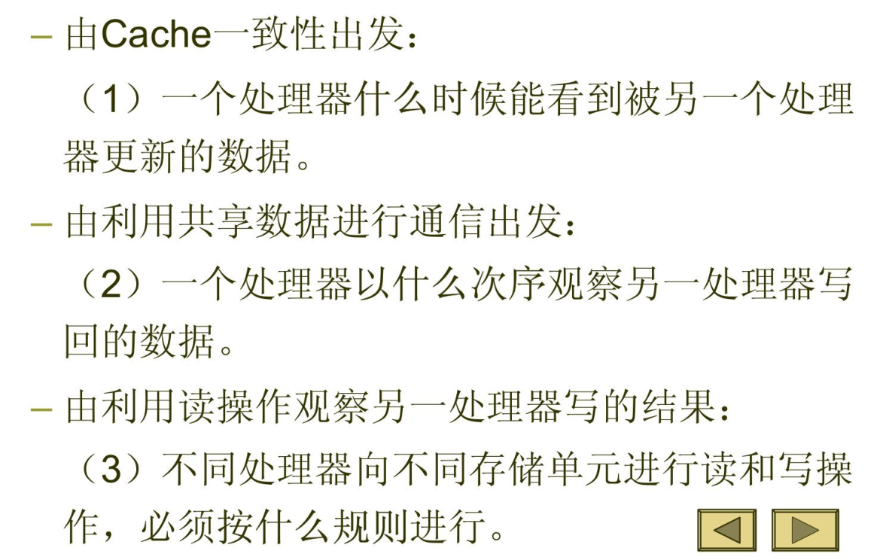
Memory Consistency
Definition:
When must a processor see a value that has been updated by another processor ?
What properties must be enforced among reads and writes to different locations by different processors ?

Slide 5
Example （ p243）
P1: A=0; P2: B=0;
… …
A=1; B=1;
L1: if ( B==0)… L2: if ( A==0)...
Assume: A,B are both cached by P1, P2 with the initial value of 0.
How about the if statement ?
Unknown, it depends !

Slide 6
Analyze the result:
P1: A=0; P2: B=0;
… …
A=1; B=1;
L1: if ( B==0)… L2: if ( A==0)...
If the write result can be seen immediately by other processors, then ….
If the write can be delayed, then …

Slide 7
Objectives of Memory Consistency Model
Defines the behavior and correctness of a program.
Impose ordering constraints
Balance programming complexity and performance

Slide 8
Sequential Consistency
Memory accesses executed by each processor were kept in order
Memory accesses among different processors were interleaved.
P1: A=0; P2: B=0;
… …
A=1; B=1;
L1: if ( B==0)… L2: if ( A==0)...
False True/false
True/false False
No way to see True Ture !

Slide 9
Sequential Consistency
Characteristic: Delay next memory access until the previous one is completed.
Simple programming paradigm
Long latency, bad performance
Even write buffer is not permitted.
Nonblocking cache ?

Slide 10
Performance analysis for Sequential Consistency
Assume
50 cycles to establish ownership when write miss；
10 cycles to issue each invalidation;
80 cycles for an invalidation to complete and be acknowledged.
4 other processors share a cache block.
Question：How long does a write miss stall the processor is SC is used？
Answer：
50 +（10+10+10+10）+ 80 = 170 （CC）

Slide 11
How to improve performance ?
Latency-hiding techniques
Less restrictive memory consistency model

Slide 12
The programmer’s View
Simple programming model
High performance implementation
Simple Programming model:
synchronized programs:
All access to shared data are ordered by synchronization operations.
A synchronized program will behave as if the hardware implemented sequential consistency.
No Data Race !

Slide 13
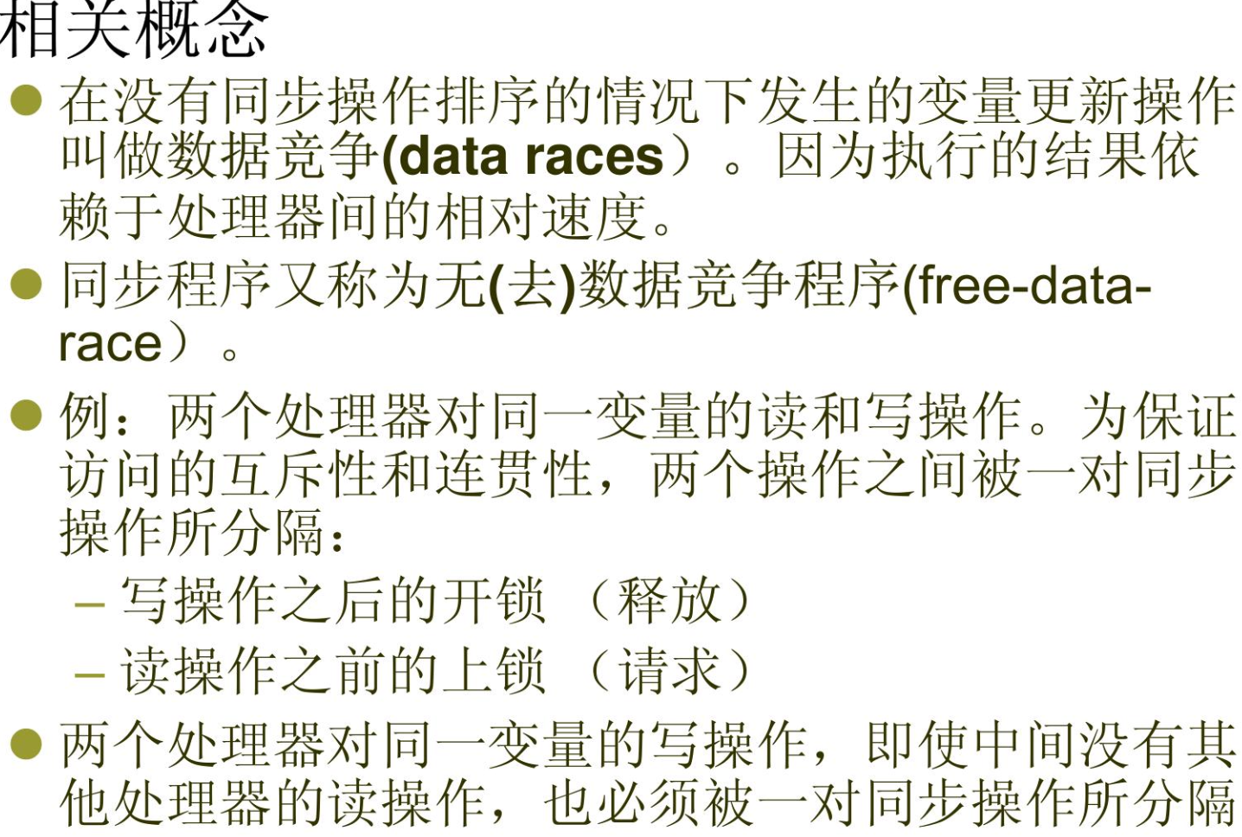
Synchronized program
A program is synchronized if all access to shared data are ordered by synchronization operations.
For any shared data x,
write( Pi, x)
Release(Pi, x)
Acquire(Pj, x)
access(Pj, x)

Slide 14
Relaxed Consistency Model
Objective:
simple programming & high performance
Key idea:
allow read and writes to complete out of order, but to use synchronization operations to enforce ordering, so that a synchronized program behave as if the processor were sequentially consistent with a better performance.
Orders:
R→W, R→R, W→ R, W→W
Sa→R, Sa →W, Sr→R, Sr→W, S→S
松 弛 连 贯 性 模 型 - - - 定 义较 少 的 读 写 隔 板 操 作，使 一些读写操作尽可能有 一些重叠，从 而实现隐藏读写延时。
Notes:
四种顺序:
- R一>R:一个读操作紧跟一个读操作;
- R -›W:
一个读操作后跟着 一个写操作，若对同 一地址进行操作，则称反相关;
- W 一>W: 一个写操作后跟着一个写操作;若对同 一地址进行操作，则称输出相关;
-W 一>R:写操作后跟 一个读操作，若对同 一地址 进行操作，则称真相关。
• 如果读写操作之问存在相关性，则单处理器程序的 语义要求操作按顺序进行。如果不存在相关性，则 由存储器连贯性模型决定哪些顺序必须被保持。

Slide 15
Memory consistency model
W→S_{A}, R→S_{A},
S_{R}→W,S_{R}→R
Notes:
顺序连费性模型:所有四种顺序都必须保持。这相 当于假设存在一个集中共享存储器，所有的存储器 操作都被串行化了。也等价于把所有的读写操作都 看成是存储器隔板操作。
• 放松一 种顺序:意味 着处理器后执行的操作可以在 一个先执行的操作完成之前先完成。
尽管顺序连贯性模型要求四种顺序都保持，但在实 际 实现时 有一定的灵活性， 可以对部分事件重新排 序，只要重新排序不被看到就可以了。
• 松弛连贯性模型的实质: 一找出那些可被看到的顺序， -只保持那些可见的顺序不变。，从而减少必须保 持的顺序的数目。 一例如两个写操作，可以允许后面的写操作在前 一个 写 操 作 完 成 前 开 始 执 行 ， ， 只 要 保 证 后 一 次 写的结果在前一次写完成前不被看到就可以了。
SA=同步操作由acquire（SA)和release组成 (SR）

Slide 16
What to decide R.W order ?
If there is data dependence, then keep the sequential order
Otherwise decided by Memory Consistency Model

Slide 17
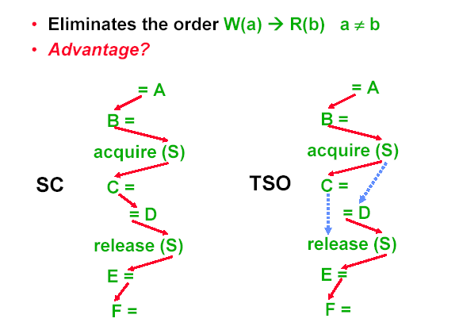
Total Store Order (IBM370)
Write buffer

Slide 18
TSO: FIFO write buffer
P1
P1
Store buffer
Store buffer
Memory

Slide 19
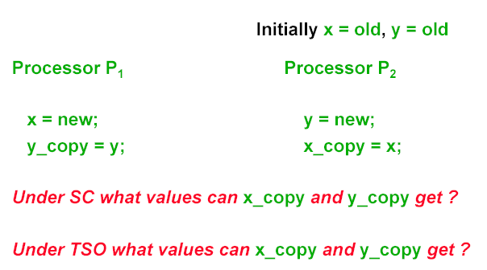
TSO vs. SC
TSO both can get old values
SC at least one has to get the value of new

Slide 20
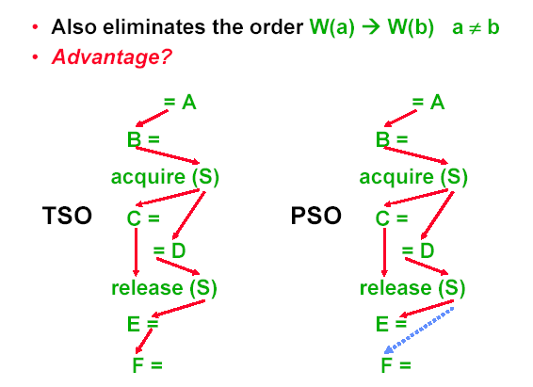
Partial Store Order (sparc)
流水化实现写操作

Slide 21
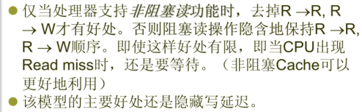
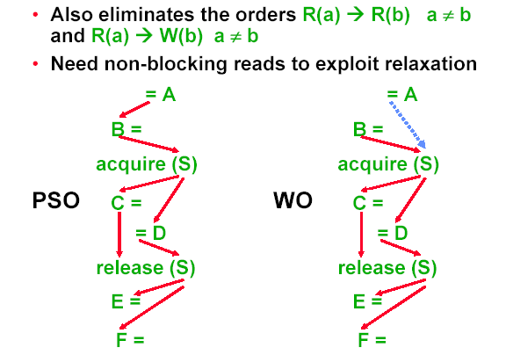
Weak ordering (PowerPC)

Slide 22
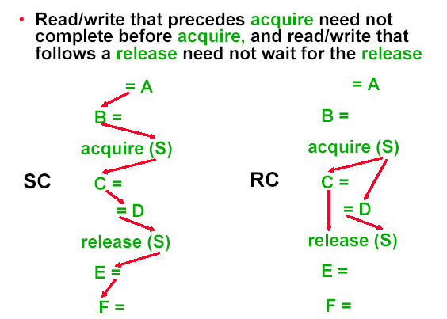
Release consistency (Alpha, MIPS)

Slide 23
Thank you !

